Slide 1
CSEN2031 -
ARTIFICIAL INTELLIGENCE
UNIT I
INTRODUCTION
Dr. M. Subramaniam,
Professor, Dept. of CSE

Slide 2
Course Educational Objectives
To understand the fundamentals of Artificial Intelligence
To solve problems by using search algorithms
To gain insight into competitive environments using adversarial search algorithms
To learn knowledge representation and knowledge representation techniques
To address the uncertainty and to learn the ways of learning

Slide 3
UNIT – I
Introduction:
  Introduction to AI
  Concept of intelligence,
  Artificial intelligence, foundational areas of AI,
  Approaches to AI- rationalist, Empiricist approaches,
  Applications of AI and limitations of AI
  Intelligent agents: agents and environments, examples, the concept of rationality, nature of environments, the structure of agents.
Reference Book
  S. Russell and P. Norvig, "Artificial Intelligence: A Modern Approach‖, Prentice Hall”, Third Edition, 2009.
  I. Bratko, ―Prolog: Programming for Artificial Intelligence‖, Fourth edition, Addison-Wesley Educational Publishers Inc., 2011

Slide 4
Artificial Intelligence
Intelligence: The ability to learn and solve problems.
The most common answer that one expects is “to make computers intelligent so that they can act intelligently…as intelligent as humans.
Intelligence, as we know, is the ability to acquire and apply the knowledge.
Knowledge is the information acquired through experience. Experience is the knowledge gained through exposure (training).
Summing the terms up, we get artificial intelligence as the “copy of something natural (i.e., human beings) ‘WHO’ is capable of acquiring and applying the information it has gained through exposure.”

Slide 5
Artificial Intelligence - Classification
Analytical
  Characteristics consistent with cognitive intelligence; generating a cognitive representation of the world and using learning based on past experience to inform future decisions.
Human Inspired
  These elements form cognitive and emotional intelligence; understanding human emotions, in addition to cognitive elements, and considering them in their decision making.
Humanized Artificial Intelligence
  This shows the characteristics of all types of competencies(i.e., cognitive, emotional & social intelligence), is able to be self- conscious and is self-aware in interactions.

Slide 6
Intelligence is composed of
Reasoning
Learning
Problem solving
Perception
Linguistic intelligence
Many tools are used in AI, including versions of
  Search and Mathematical optimization,
  Logic,
  Methods based on probability and economics.
  The AI field draws upon computer science, mathematics, psychology, linguistics, philosophy, neuro-science, artificial psychology and many others.

Slide 7
Intelligence is composed of
Reasoning:
  The ability to analyze information and draw logical conclusions.
  AI systems use reasoning to make informed decisions based on existing knowledge or learned rules.
Learning:
  The capability to acquire new data and create or refine algorithms (rules) to improve performance over time, without being explicitly programmed for every scenario.
  Machine learning, a core branch of AI, encompasses various techniques like supervised, unsupervised, and reinforcement learning.

Slide 8
Intelligence is composed of
Problem Solving:
  The process of identifying a problem and systematically searching through a range of possible actions to reach a predefined goal or solution.
Perception:
  The ability to use sensory inputs (like data from cameras, microphones, and other sensors) to interpret and understand the surrounding environment.
Linguistic Intelligence (Natural Language Processing):
  The capacity to understand, interpret, and generate human language (both written and spoken), enabling seamless communication between humans and machines.

Slide 9
Major tools & methods used in AI
Search (state-space and adversarial search)
  Algorithms: BFS, DFS, A*, Iterative Deepening A* - IDA* (for pathfinding), minimax + alpha-beta pruning (games).
  Use-cases: path planning for robots, GPS and Route Planning, puzzle solvers (Rubik’s cube solvers), game playing (chess, Go).
Mathematical optimization
  Continuous: gradient descent, stochastic gradient descent (SGD), Adam — used to train neural networks.
  Constrained / combinatorial: linear programming, integer programming, convex optimization, Lagrangian methods.
  Metaheuristics: genetic algorithms, simulated annealing, particle swarm optimization for non-convex or discrete problems.
  Use-cases: training models, hyperparameter tuning, resource allocation, route/schedule optimization.

Slide 10
Mathematical optimization
1. Linear Programming (LP):
  Resource Allocation: Optimizing the distribution of limited resources (e.g., labor, materials, budget) to maximize output or minimize costs in manufacturing, agriculture, or project management.
  Production Planning: Determining optimal production schedules and quantities to meet demand while minimizing inventory costs and maximizing profit.
  Transportation and Logistics: Optimizing delivery routes, scheduling freight, and managing supply chains to reduce shipping costs and improve efficiency.
  Diet Planning: Formulating diets that meet nutritional requirements at minimal cost.
2. Integer Programming (IP):
  Scheduling: Creating optimal schedules for tasks, employees, or machines where decisions are discrete (e.g., assigning a specific task to a specific person).
  Network Design: Designing communication networks, transportation networks, or facility layouts where components are discrete units (e.g., number of routers, location of warehouses).
  Capital Budgeting: Selecting investment projects from a set of options to maximize returns within budget constraints.
  Cutting Stock Problems: Minimizing waste when cutting materials (e.g., paper, fabric, metal) into smaller pieces of specified sizes.

Slide 11
Mathematical optimization
3. Convex Optimization:
  Machine Learning: Training models such as Support Vector Machines (SVMs) and logistic regression, where the optimization problem is typically convex.
  Signal Processing: Designing filters, compressing signals, and recovering signals from noisy data.
  Control Systems: Designing optimal controllers for dynamic systems, ensuring stability and performance.
  Finance: Portfolio optimization, risk management, and option pricing.
4. Lagrangian Methods (Lagrangian Relaxation and Duality):
  Decomposition Techniques: Solving large-scale, complex optimization problems by breaking them down into smaller, more manageable subproblems, often used in conjunction with other methods like branch and bound for integer programming.
  Resource Allocation with Hard Constraints: Relaxing "hard" constraints in optimization problems to obtain lower bounds on the optimal solution, particularly useful in integer programming where finding exact solutions can be computationally expensive.
  Network Optimization: Applying Lagrangian relaxation to problems like network flow, shortest path, and minimum spanning tree problems to find efficient solutions.
  Distributed Optimization: Enabling optimization in decentralized systems where different parts of the problem are handled by separate entities.

Slide 12
Major tools & methods used in AI
Logic (symbolic methods)
  Propositional / First-order logic: rule-based expert systems, theorem provers.
  Description logics / ontologies: semantic web, knowledge representation (OWL).
  Use-cases: explainable reasoning, knowledge bases, program verification.
Probability & statistics
  Bayesian methods: Bayesian networks, hidden Markov models (HMMs), Kalman filters.
  Probabilistic inference: (Markov Chain Monte Carlo) MCMC, variational inference.
  Use-cases: sensor fusion, uncertainty modeling, probabilistic reasoning (diagnosis, forecasting).

Slide 13
Major tools & methods used in AI
Economical / game-theoretic methods
  Game theory: Nash equilibria, mechanism design — modeling multi-agent strategic interactions.
  Auctions & incentives: used in resource allocation (e.g., ad auctions) and mechanism design for truthful reporting.
  Reinforcement learning & decision theory: expected utility, inverse reinforcement learning (understanding preferences).
  Use-cases: multi-agent systems, auctions, market simulations, negotiation agents.
Linear algebra & numerical methods
  Core to ML: matrix operations, SVD, eigenanalysis — implemented efficiently on hardware (GPUs/TPUs).
  Use-cases: embeddings, PCA, spectral clustering, training neural networks.

Slide 14
Major tools & methods used in AI
Information theory
  Concepts: entropy, Kullback-Leibler (KL) divergence, mutual information — used to measure uncertainty, regularization, representation learning objectives.
Control theory
  PID controllers, model predictive control (MPC), robust control.
  Use-cases: robotics, autonomous vehicles, stabilizing dynamic systems.
Heuristics & knowledge engineering
  Human-crafted heuristics and domain knowledge to speed search or improve interpretations in low-data regimes.

Slide 15
Disciplines AI draws upon — what each brings
Computer Science
  Algorithms, data structures, complexity, distributed systems, software engineering.
Implements models efficiently and scales systems to production.
Mathematics
  Linear algebra, probability, statistics, optimization, graph theory — the formal backbone of models and proofs.
Psychology & Cognitive Science
  Models of human learning and reasoning, cognitive architectures (Soar, ACT-R), human-computer interaction.
  Inspire architectures and evaluation methods; inform usability and human-centered design.
Linguistics
  Syntax, semantics, pragmatics inform NLP models, grammar formalisms, discourse modeling, and evaluation of language understanding.

Slide 16
Disciplines AI draws upon — what each brings
Philosophy
  Epistemology (what is knowledge?), logic, ethics — informs interpretability, fairness, and conceptual foundations (what is intelligence?).
Neuroscience
  Insights into how biological brains learn and represent information (spiking neurons, hierarchical processing) inspire algorithms and architectures.
Economics
  Decision theory, incentives, auctions, mechanism design guide design for multi-agent environments and marketplace systems (ads, marketplaces).
Statistics
  Experimental design, inference, hypothesis testing — necessary for validating models and understanding uncertainty.

Slide 17
Disciplines AI draws upon — what each brings
Control & Robotics / Electrical Engineering
  Sensors, actuators, control loops, embedded systems — enable real-world autonomous agents.
Other fields
  Operations research: optimization for logistics and scheduling.
  Ethics & law: regulation, accountability, privacy-preserving techniques.
  Domain fields (medicine, finance, biology, etc.): provide domain knowledge and evaluation criteria.

Slide 18
Need for Artificial Intelligence
To create expert systems which exhibit intelligent behavior with the capability to learn, demonstrate, explain and advice its users.
Helping machines find solutions to complex problems like humans do and applying them as algorithms in a computer-friendly manner.

Slide 19
Approaches to AI
Artificial Intelligence has two fundamental philosophical foundations:
  Rationalist Approach (Knowledge-based / Logic-based)
  Empiricist Approach (Experience-based / Learning-based)
Both approaches differ in how intelligence is acquired and how AI systems solve problems.

Slide 20
Rationalist Approach (Rationalism)
Knowledge and intelligence come from reasoning, logic, and innate principles, not from direct experience.
The system is built using explicit knowledge and logical rules.
How it works:
  Human experts provide knowledge
  Problem is converted into rules, logic statements, or mathematical reasoning
  AI system uses deduction, inference, and symbolic reasoning
Techniques Include:
  Rule-based systems
  Expert systems
  Logic programming (Prolog)
  Knowledge graphs
  Ontologies
  Planning and search algorithms

Slide 21
Rationalist Approach
Advantages:
  Transparent and explainable
  Works well for structured problems
  Easy to debug because rules are explicit
Limitations:
  Requires a lot of manual knowledge engineering
  Cannot handle noise or uncertainty well
  Not suitable for learning from large data
Real-Time Example:
  A medical diagnosis expert system with rules like:
  IF fever AND cough THEN suspect flu
  Chess programs using logical search
  Debuggers/Compilers using logical rule sets

Slide 22
Empiricist Approach (Empiricism)
Knowledge comes from experience, observation, and data.
The system learns patterns from examples rather than from manually coded rules.
How it works:
  Large dataset is provided
  Statistical/machine learning models extract patterns
  System improves performance with more training data
Techniques Include:
  Machine Learning (ML)
  Deep Learning
  Neural Networks
  Reinforcement Learning
  Probabilistic models (Bayesian networks)

Slide 23
Empiricist Approach (Empiricism)
Advantages:
  Learns automatically from data
  Can handle noise, uncertainty, and complex patterns
  Very powerful for vision, speech, NLP
Limitations:
  Needs large datasets
  Less interpretable (“black-box”)
  Performance depends on data quality
Real-Time Example:
  Facebook/Instagram recognizing faces from photos
  Google predicting traffic using past data
  Voice assistants learning speech patterns (Siri, Alexa)

Slide 24
Applications of AI
Natural Language Processing
Gaming
Speech Recognition
Vision Systems
Healthcare
Automotive

Slide 25
Artificial Intelligence
An AI system is composed of an agent and its environment.
An agent(e.g., human or robot) is anything that can perceive its environment through sensors and acts upon that environment through effectors.
Intelligent agents must be able to set goals and achieve them.
Natural language processing gives machines the ability to read and understand human language, includes information retrieval, text mining, question answering and machine translation.

Slide 26
Artificial Intelligence
Machine perception is the ability to use input from sensors (such as cameras, microphones, sensors etc.) to deduce aspects of the world. e.g., Computer Vision.
Concepts such as game theory, decision theory, necessitate that an agent be able to detect and model human emotions.

Slide 27
Goals of AI Research
Reasoning
Knowledge representation
Planning
Learning
Natural language processing
Perception and the ability to move and manipulate objects.

Slide 28
Challenges of AI
The overall research goal of artificial intelligence is to create technology that allows computers and machines to function in an intelligent manner.
The general problem of simulating (or creating) intelligence has been broken down into sub-problems.
These consist of particular capabilities that researchers expect an intelligent system to display

Slide 29
Reasoning, problem solving
Problem solving refers to cognitive processing directed at achieving a goal when the problem solver does not initially know a solution method.
A problem exists when someone has a goal but does not know how to achieve it.
Problems can be classified as routine or non-routine, and as well defined or ill defined.
It is a mental process in psychology and a computerized process in computer science.
  Well-defined problems have specific end goals and clear expected solutions, while ill-defined problems do not.
  Well-defined problems allow for more initial planning than ill-defined problems

Slide 30
Knowledge representation
Knowledge-representation(KR) is a field of artificial intelligence that focuses on designing computer representations that capture information about the world that can be used to solve complex problems.
Example:
  Diagnosing a medical condition or having a dialog in a natural language.
KR incorporates findings from psychology about how humans solve problems and represent knowledge in order to design formalisms that will make complex systems easier to design and build.

Slide 31
Knowledge representation
Knowledge representation and reasoning also incorporates findings from logic to automate various kinds of reasoning, such as the application of rules or the relations of sets and subsets.
  Examples of knowledge representation formalisms include
    Semantic network or Frame network,
    Systems architecture,
    Frames, rules, and
    Ontologies.
    Examples of automated reasoning engines include inference engines, theorem provers, and classifiers.

Slide 32
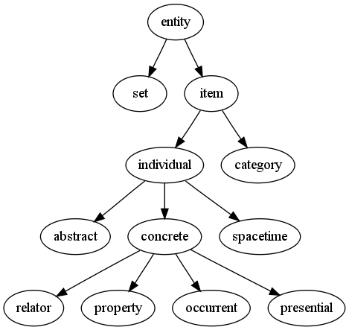
An ontology represents knowledge as a set of concepts within a domain and the relationships between those concepts.

Slide 33
Planning
Intelligent agents must be able to set goals and achieve them.
They need a way to visualize the future—a representation of the state of the world and be able to make predictions about how their actions will change it—and be able to make choices that maximize the utility (or "value") of available choices.
In classical planning problems, the agent can assume that it is the only system acting in the world, allowing the agent to be certain of the consequences of its actions.

Slide 34
Planning
However, if the agent is not the only actor, then it requires that the agent can reason under uncertainty.
This calls for an agent that can not only assess its environment and make predictions, but also evaluate its predictions and adapt based on its assessment.
Multi-agent planning uses the cooperation and competition of many agents to achieve a given goal.
Emergent behavior such as this is used by evolutionary algorithms and swarm intelligence

Slide 35
Machine Learning
Machine Learning is the field of study that gives computers the capability to learn without being explicitly programmed
ML; it gives the computer that which makes it more similar to humans: The ability to learn.
On basis of the nature of the learning “signal” or “feedback” available to a learning system.
  Supervised learning
  Unsupervised learning

Slide 36
Machine Learning
Supervised learning: The computer is presented with example inputs and their desired outputs, given by a “teacher”, and the goal is to learn a general rule that maps inputs to outputs.
The training process continues until the model achieves the desired level of accuracy on the training data.
Some real-life examples are:
  Image Classification: You train with images/labels. Then in the future you give a new image expecting that the computer will recognize the new object.
  Market Prediction/Regression: You train the computer with historical market data and ask the computer to predict the new price in the future.

Slide 37
Machine Learning
Unsupervised learning:
No labels are given to the learning algorithm, leaving it on its own to find structure in its input.
It is used for clustering population in different groups.
Unsupervised learning can be a goal in itself (discovering hidden patterns in data).
  Clustering: You ask the computer to separate similar data into clusters, this is essential in research and science.
  High Dimension Visualization: Use the computer to help us visualize high dimension data.
  Generative Models: After a model captures the probability distribution of your input data, it will be able to generate more data. This can be very useful to make your classifier more robust.

Slide 38
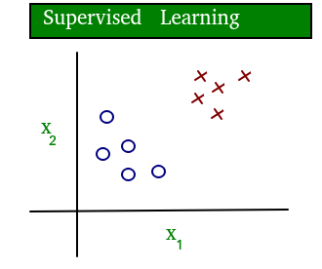
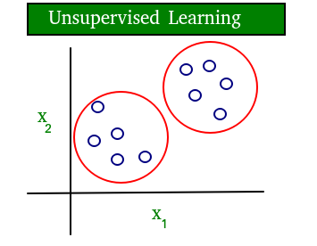
Diagram- supervised and unsupervised learning
The data in supervised learning is labeled, where as data in unsupervised learning is unlabeled

Slide 39
Machine Learning
Semi-supervised learning:
  Problems where you have a large amount of input data and only some of the data is labeled, are called semi-supervised learning problems.
  These problems sit in between both supervised and unsupervised learning.
    For example, a photo archive where only some of the images are labeled, (e.g. dog, cat, person) and the majority are unlabeled.

Slide 40
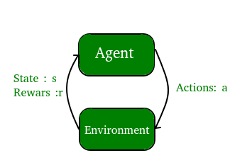
Machine Learning
Reinforcement learning
  A computer program interacts with a dynamic environment in which it must perform a certain goal (such as driving a vehicle or playing a game against an opponent).
  The program is provided feedback in terms of rewards and punishments as it navigates its problem space

Slide 41
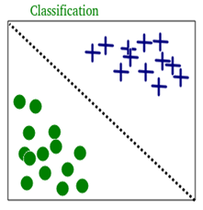
Machine Learning
Classification:
  Inputs are divided into two or more classes, and the learner must produce a model that assigns unseen inputs to one or more (multi-label classification) of these classes.
  This is typically tackled in a supervised way.
  Spam filtering is an example of classification, where the inputs are email messages and the classes are “spam” and “not spam”.

Slide 42
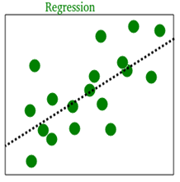
Machine Learning
Regression:
It is also a supervised learning problem, but the outputs are continuous rather than discrete. For example, predicting the stock prices using historical data.
An example of classification and regression on two different datasets is shown below

Slide 43

Machine Learning
Clustering:
Here, a set of inputs is to be divided into groups. Unlike in classification, the groups are not known beforehand, making this typically an unsupervised task.
As you can see in the example below, the given dataset points have been divided into groups identifiable by the colors red, green and blue.

Slide 44
Machine Learning
Density estimation:
  The task is to find the distribution of inputs in some space.
Dimensionality reduction:
  It simplifies inputs by mapping them into a lower-dimensional space.
  Topic modeling is a related problem, where a program is given a list of human language documents and is tasked to find out which documents cover similar topics.

Slide 45
ML Algorithms
UNSUPERVISED – Clustering
SUPERVISED - Classification
Linear Regression
Logistic Regression
SVM (Support Vector Machines)
Naive Bayes
Random Forest
Decision Trees
KNN (K Nearest Neighbors)
K-Means
Principal Component Analysis
Hierarchical Clustering.

Slide 46
ML Tools and Frameworks
Scikit Learn
TensorFlow
Auto ML
Theano
PyTorch
Caffe
MxNet
Google ML Kit
Keras
H20: Open Source AI Platform
CNTK
OpenNN

Slide 47
Natural Language Processing (NLP)
NLP is an AI field merging computer science, linguistics, and machine learning to help computers understand, interpret, generate, and respond to human language (text and speech).
It converts unstructured human language into structured data for computers to process, powering everyday tools like search engines, voice assistants (Siri, Alexa), chatbots, translation apps, and spam filters, making human-computer interaction seamless and automating tasks.

Slide 48
How it works
Combines disciplines: Uses linguistics (language rules) with statistical models, machine learning, and deep learning to process language.
Two main tasks:
  Natural Language Understanding (NLU): Comprehending input (text/speech) by breaking down meaning and structure.
  Natural Language Generation (NLG): Producing human-like text or speech as output.
Process: Translates messy human language into organized data for machines, then back again

Slide 49
Applications
Voice Assistants: Siri, Alexa, Google Assistant.
Search Engines: Understanding queries and providing relevant results.
Chatbots & Virtual Agents: Customer service, AI assistants.
Translation: Google Translate.
Text Analysis: Sentiment analysis, spam detection, autocorrect, plagiarism checks.
Enterprise Automation: Streamlining business processes, productivity tools

Slide 50
ML - Terminologies
Model
  A model is a specific representation learned from data by applying some machine learning algorithm. A model is also called hypothesis.
Feature
  A feature is an individual measurable property of our data. A set of numeric features can be conveniently described by a feature vector.
  Feature vectors are fed as input to the model. For example, in order to predict a fruit, there may be features like color, smell, taste, etc.
    Note: Choosing informative, discriminating and independent features is a crucial step for effective algorithms. We generally employ a feature extractor to extract the relevant features from the raw data.

Slide 51
ML - Terminologies
Target (Label)
  A target variable or label is the value to be predicted by our model. For the fruit example discussed in the features section, the label with each set of input would be the name of the fruit like apple, orange, banana, etc.
Training
  The idea is to give a set of inputs (features) and it’s expected outputs(labels), so after training, we will have a model (hypothesis) that will then map new data to one of the categories trained on.
Prediction
  Once our model is ready, it can be fed a set of inputs to which it will provide a predicted output (label).

Slide 52
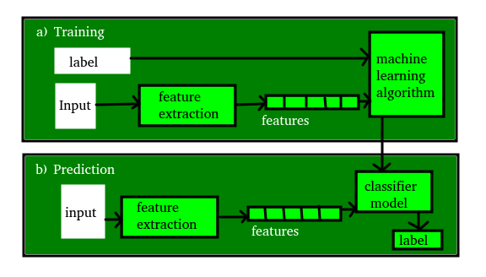

Slide 53
Agents in Artificial Intelligence
Artificial intelligence is defined as a study of Rational agents.
  A rational agent could be anything which makes decisions, as a person, firm, machine, or software.
  It carries out an action with the best outcome after considering past and current percepts (agent’s perceptual inputs at a given instance).
  An AI system is composed of an agent and its environment. The agents act in their environment. The environment may contain other agents. An agent is anything that can be viewed as:
    Perceiving its environment through sensors and
    Acting upon that environment through actuators

Slide 54
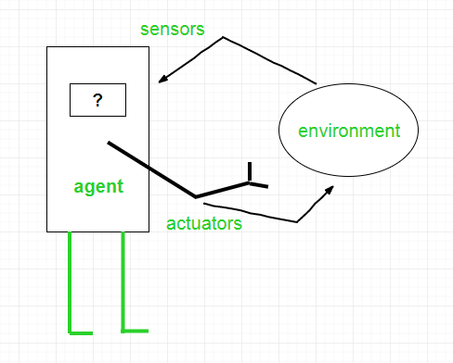
Agent = Architecture + Agent Program
Architecture is the machinery that the agent executes on.
It is a device with sensors and actuators, for example :
  Robotic car, Camera, PC.
Agent program is an implementation of an agent function.
An agent function is a map from the percept sequence (history of all that an agent has perceived till date) to an action.
Examples of Agent:-
A software agent has Keystrokes, file contents, received network packages which act as sensors and displays on the screen, files, sent network packets acting as actuators.
A Human agent has eyes, ears, and other organs which act as sensors and hands, legs, mouth, and other body parts acting as actuators.
A Robotic agent has Cameras and infrared range finders which act as sensors and various motors acting as actuators.

Slide 55
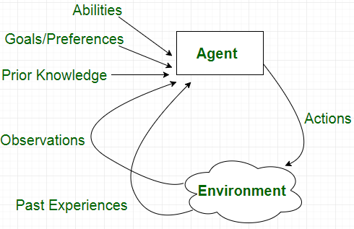

Slide 56
Types of Agents
Simple Reflex Agents
Model-Based Reflex Agents
Goal-Based Agents
Utility-Based Agents
Learning Agent

Slide 57
Simple reflex agents
Simple reflex agents ignore the rest of the percept history and act only on the basis of the current percept.
  Percept history is the history of all that an agent has perceived till date.
The agent function is based on the condition-action rule.
  A condition-action rule is a rule that maps a state i.e., condition to an action.
  If the condition is true, then the action is taken, else not.
  This agent function only succeeds when the environment is fully observable.

Slide 58
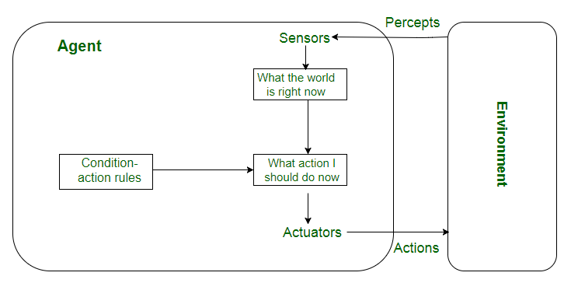

Slide 59
Model-based reflex agents
It works by finding a rule whose condition matches the current situation.
A model-based agent can handle partially observable environments by use of model about the world.
The agent has to keep track of internal state which is adjusted by each percept and that depends on the percept history.
The current state is stored inside the agent which maintains some kind of structure describing the part of the world which cannot be seen.
Updating the state requires information about :
  How the world evolves in-dependently from the agent, and
  How the agent actions affects the world.

Slide 60
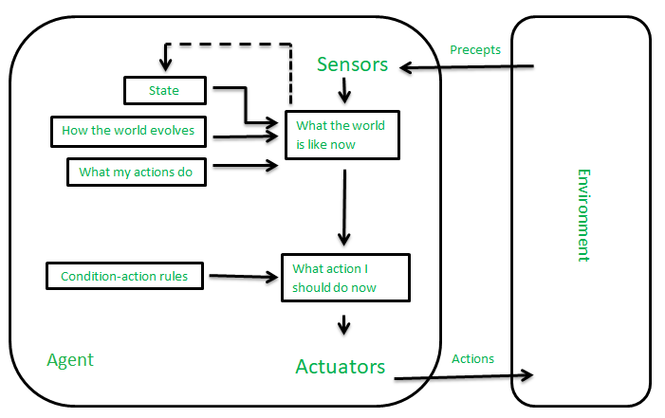

Slide 61
Goal-based agents
These kind of agents take decision based on how far they are currently from their goal(description of desirable situations).
Their every action is intended to reduce its distance from the goal.
This allows the agent a way to choose among multiple possibilities, selecting the one which reaches a goal state.
The knowledge that supports its decisions is represented explicitly and can be modified, which makes these agents more flexible.
They usually require search and planning.
The goal-based agent’s behavior can easily be changed.

Slide 62
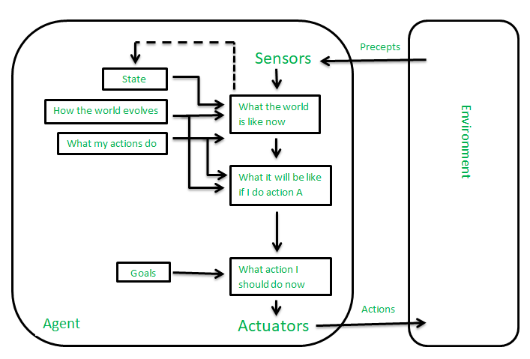

Slide 63
Utility-based agents
The agents which are developed having their end uses as building blocks are called utility based agents.
When there are multiple possible alternatives, then to decide which one is best, utility-based agents are used.
They choose actions based on a preference (utility) for each state.
Sometimes achieving the desired goal is not enough.
We may look for a quicker, safer, cheaper trip to reach a destination.
Agent happiness should be taken into consideration.
Utility describes how “happy” the agent is.
Because of the uncertainty in the world, a utility agent chooses the action that maximizes the expected utility.
A utility function maps a state onto a real number which describes the associated degree of happiness.

Slide 64
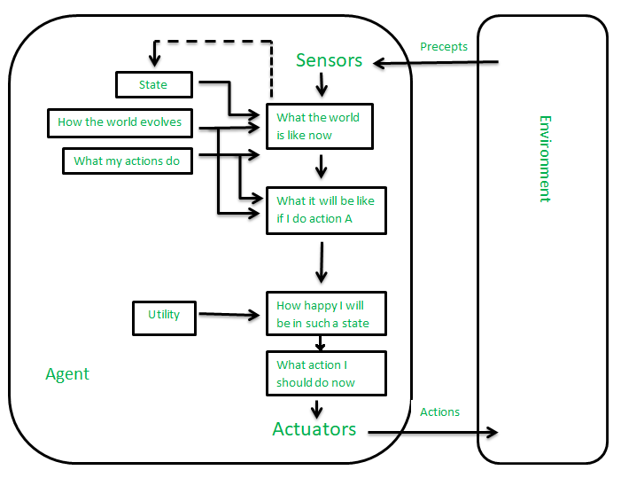

Slide 65
Learning Agent
A learning agent in AI is the type of agent which can learn from its past experiences or it has learning capabilities.
It starts to act with basic knowledge and then able to act and adapt automatically through learning.
A learning agent has mainly four conceptual components, which are:
  Learning element :
    It is responsible for making improvements by learning from the environment
  Critic:
    Learning element takes feedback from critic which describes how well the agent is doing with respect to a fixed performance standard.
  Performance element:
    It is responsible for selecting external action
  Problem Generator:
    This component is responsible for suggesting actions that will lead to new and informative experiences.

Slide 66
